Slide 1

Shark Attack Data Cleaning & Analysis
Bootcamp Mini Project
Team: Hanane, Radhika, Kanak

Slide 2
Project Goals & Hypotheses
Our primary objective was to refine a complex, real-world shark attack dataset through meticulous cleaning and then rigorously test specific hypotheses.
Data Cleaning Objective
Hypothesis 1: Geographic Variation
Hypothesis 2: Provocation Factor
Transform a messy dataset into a structured, analysis-ready format.
Shark attack incidents exhibit distinct patterns across different countries.
There's a clear distinction between provoked and unprovoked shark attacks.
Hypothesis 3: Species Impact
Bonus Hypothesis: Activity Link
Certain shark species are more frequently involved in attacks than others.
Specific human activities (e.g., Surfing, Swimming, Fishing) are significantly correlated with shark incidents.

Slide 3





Initial Data Challenges
Before any analysis could begin, the raw dataset presented numerous inconsistencies and quality issues that required extensive cleaning.
Missing Values
Inconsistent Geography
Messy Species Descriptions
Significant gaps in critical fields, requiring careful handling or imputation.
Country names were often misspelled or varied in format, hindering accurate aggregation.
Free-text entries with extraneous information, measurements, and colloquialisms.
Non-Numeric Ages
Unstructured Activity
Age data included text like "teen," "50+," or "18 months," making direct analysis impossible.
Activity descriptions were free-form text, making categorization challenging.

Slide 4
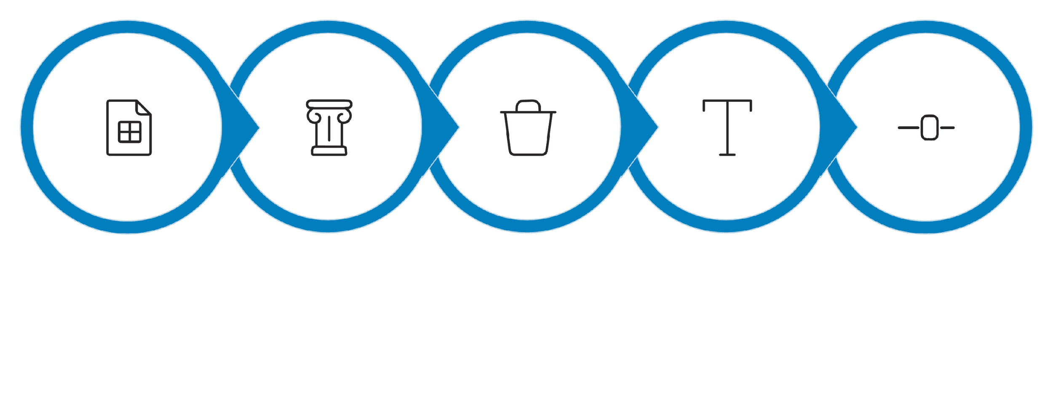




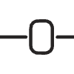
Our Data Cleaning Pipeline
We implemented a robust pipeline to transform the raw data into a clean, structured format, ready for analytical exploration.
Column Select
Raw Excel
Drop Nulls
String Clean
Normalize
This systematic approach ensured data integrity and consistency, making subsequent analysis reliable and efficient. Key techniques included regex for pattern matching, median imputation for missing age values, and standardized categorization for improved data quality.

Slide 5

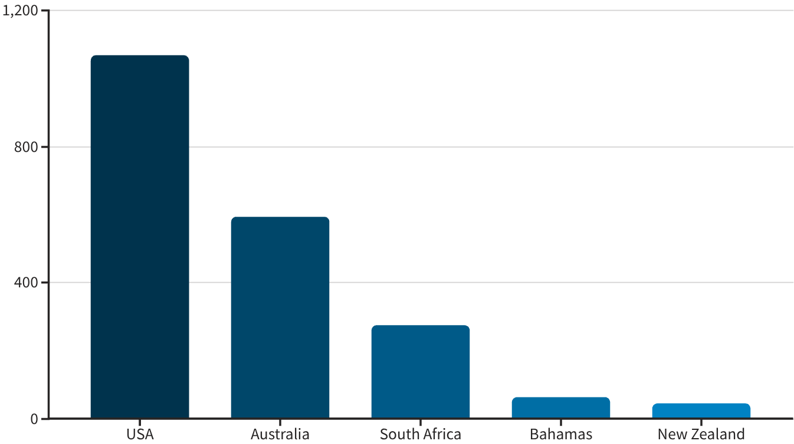
Top 5 Countries by Shark Attacks
After cleaning and standardization, we identified the countries with the highest recorded shark attack incidents.
The United States and Australia clearly lead in the number of recorded shark attack incidents within our cleaned dataset, significantly surpassing other nations.
This data supports our hypothesis that shark attacks differ significantly by country, likely influenced by factors such as coastline length, population density, and prevalence of specific shark species.

Slide 6

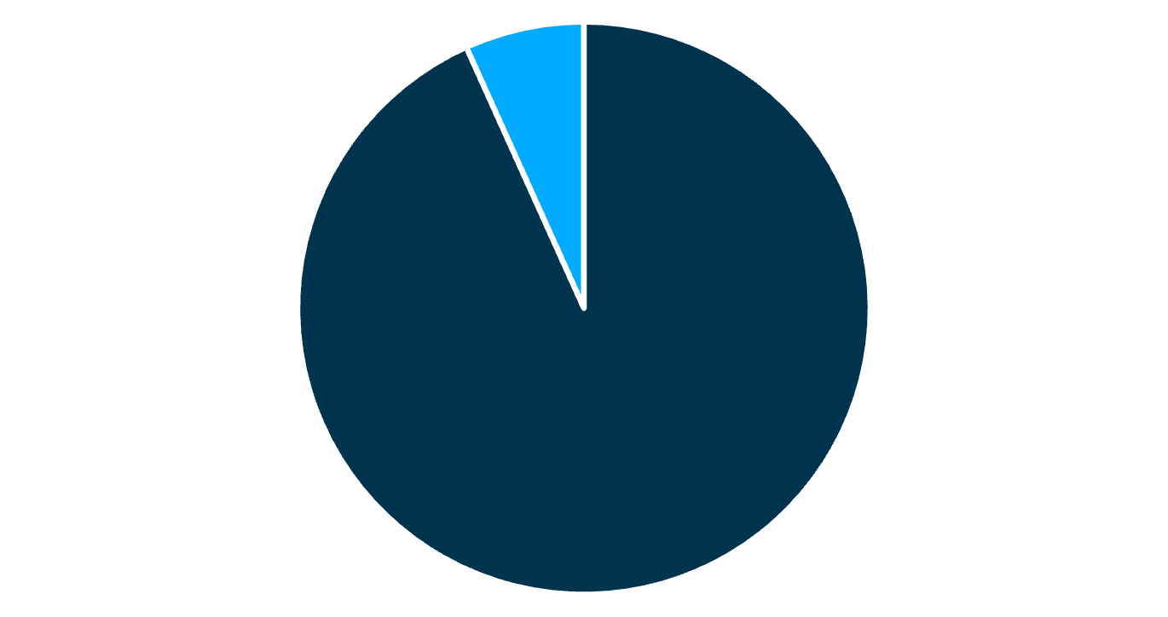
Attack Type Distribution
Analyzing the cleaned data reveals a clear imbalance between provoked and unprovoked shark attacks.
Unprovoked
Provoked
Our analysis definitively shows that the vast majority of shark attacks are categorized as unprovoked, accounting for 93.3% of all incidents in our dataset.
This finding strongly supports our second hypothesis and is crucial for understanding the true nature of shark-human interactions, often dispelling common misconceptions.

Slide 7

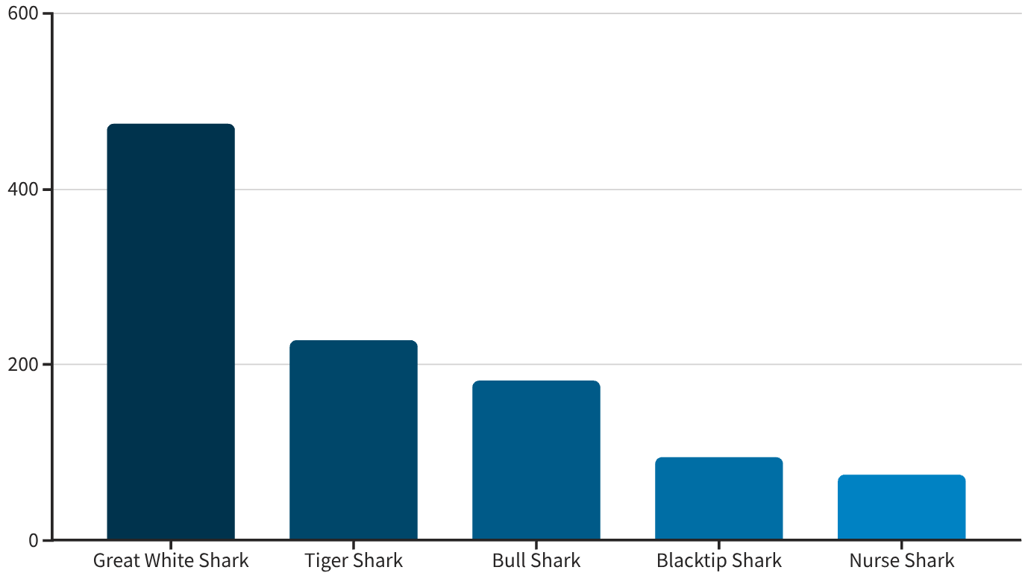
Attack Type Distribution
Focusing on the five most frequently identified species, we observe significant differences in their involvement in attacks.
The Great White Shark accounts for the largest proportion of incidents among our filtered top five species, highlighting its prominence in recorded attacks.
This finding confirms our hypothesis that certain shark species are more frequently involved in attacks, providing valuable insight into specific risk factors and species-specific behavior.

Slide 8
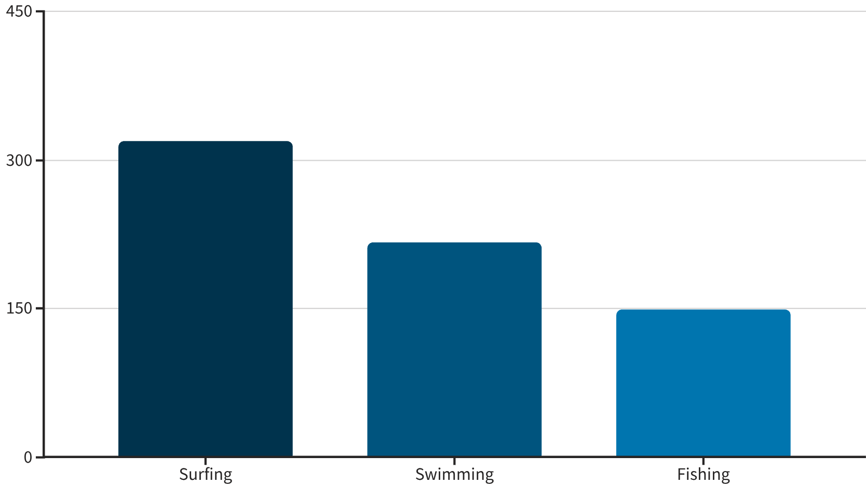
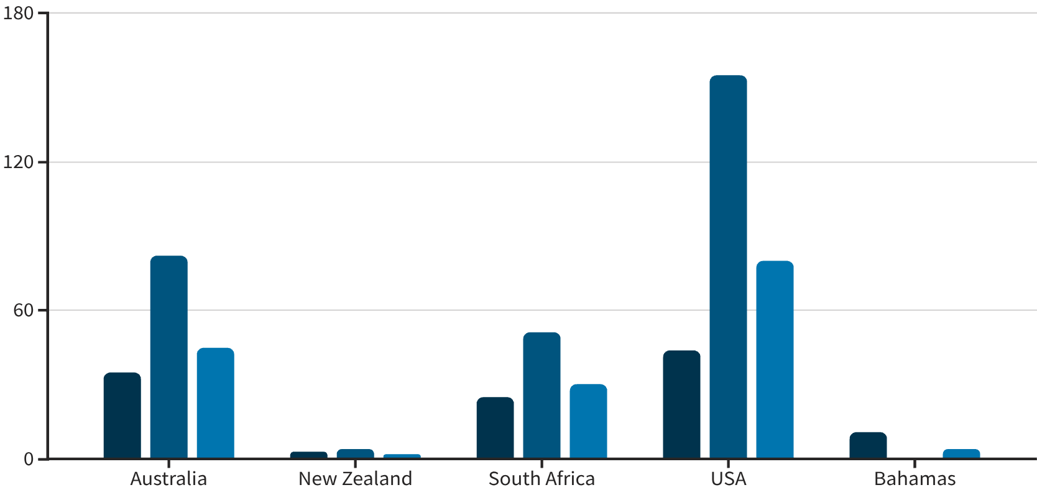
Top Activities Linked to Incidents
Our analysis reveals specific human activities that are most frequently associated with shark attack incidents.
Surfing emerges as the most common activity recorded in these incidents, followed by swimming and fishing.
This data validates our bonus hypothesis, indicating a clear link between specific recreational activities and higher risk of shark encounters. Understanding these patterns can inform safety guidelines.
Fishing
Surfing
Swimming

Slide 9



Conclusion & Key Learnings
Our mini-project successfully transformed raw, unstructured data into actionable insights, validating our initial hypotheses.
Hypotheses Supported
The Power of Data Cleaning
Valuable Techniques
All initial hypotheses regarding geographic, provocation, species, and activity-related patterns were confirmed by the cleaned data.
Meticulous data cleaning was essential; it enabled meaningful grouping, accurate charts, and reliable conclusions that were impossible with the raw data.
Mastering regex, string standardization, and robust categorization techniques are critical skills for any data professional.
Thank you for your attention!
Q&A

Slide 10


Beyond the Bites
This project showcased the transformative power of data cleaning and exploratory data analysis in uncovering hidden patterns within real-world datasets.
The insights gained not only addressed our initial hypotheses but also demonstrated how structured data empowers informed understanding and decision-making.
For more details on the cleaning scripts and methodology, please contact the team.

